Slide 1

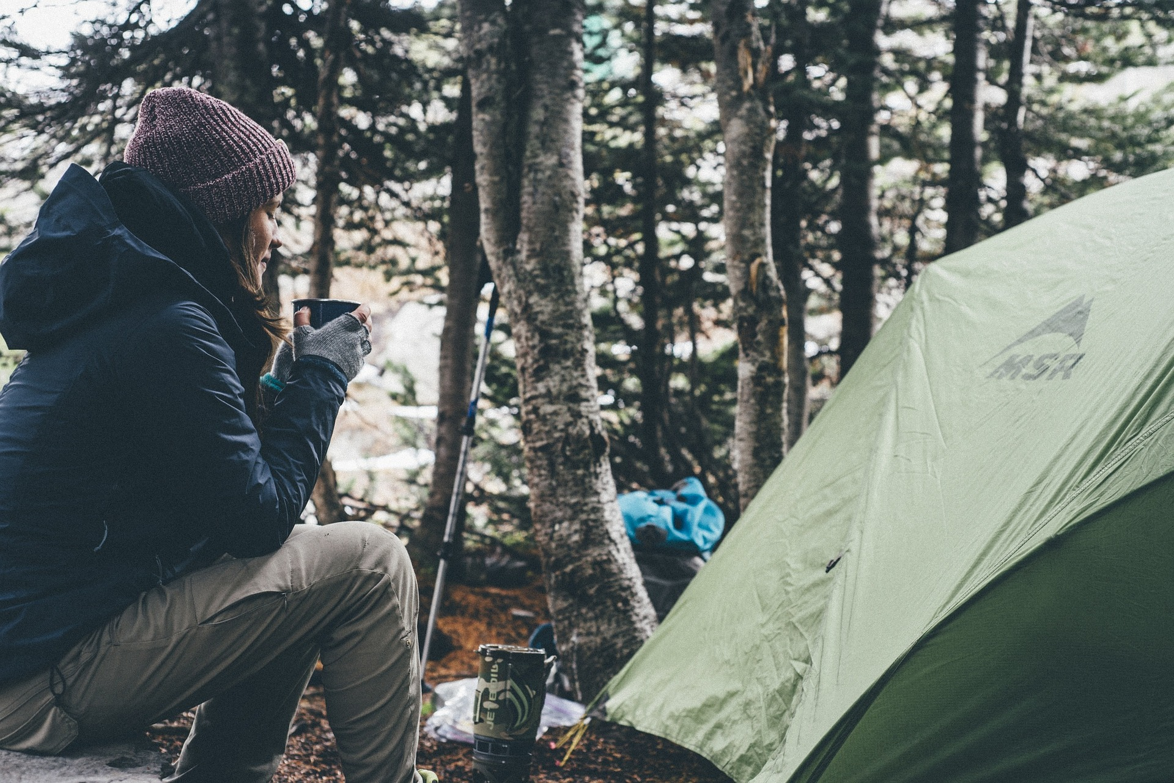

BackPacker Magazine
“Backpacker Magazine’s true mission is to provide readers with the knowledge, skills, and network to facilitate exploration of our beautiful world.”

Slide 2

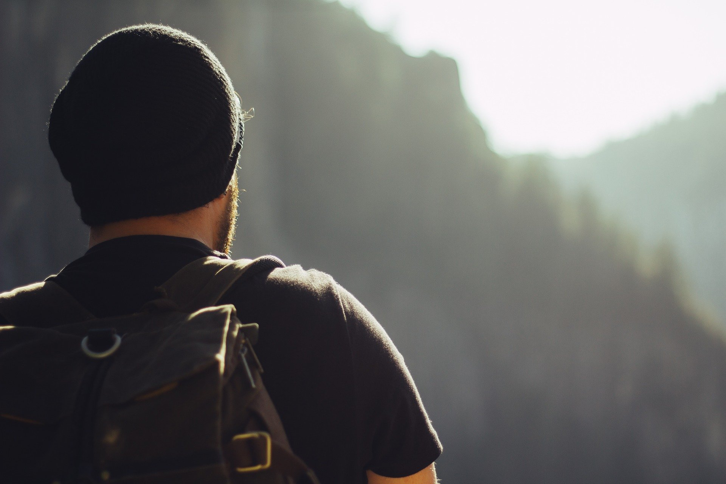

Our Audience
What do we know about our readers?
Age, Education Level, Expectations, Cultural Perspective, etc.

Slide 3



How can we use this knowledge to better serve our readers?

Slide 4
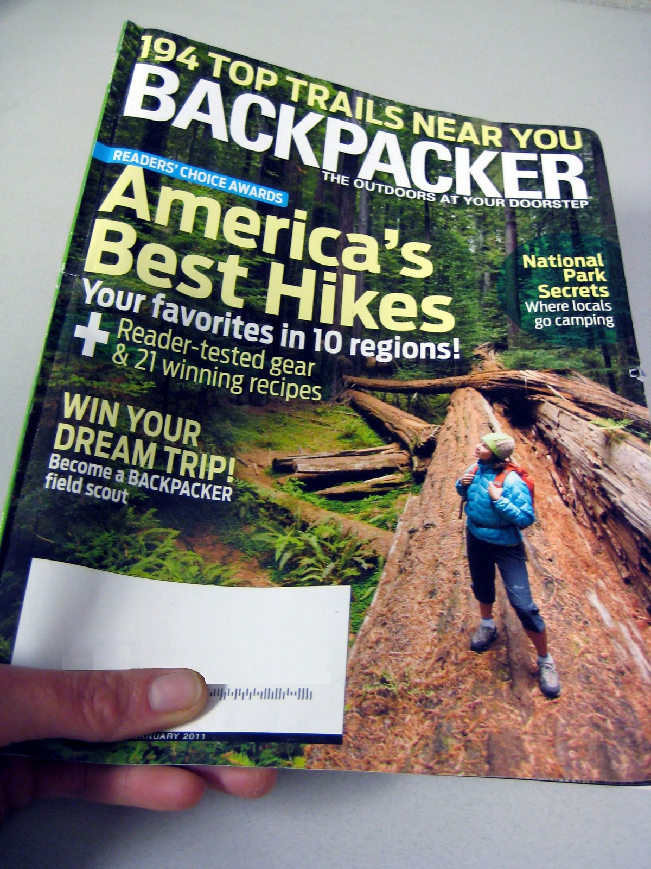
What are we doing Right?
Allowing our readers to share their personal stories.
Connecting people to interesting places.
Providing information to facilitate adventure.

Slide 5

Analyzing the Negative
~Cluttered
~Difficulty of Navigation
~Content Tagging

Slide 6
What Does Cluttered mean?

Slide 7
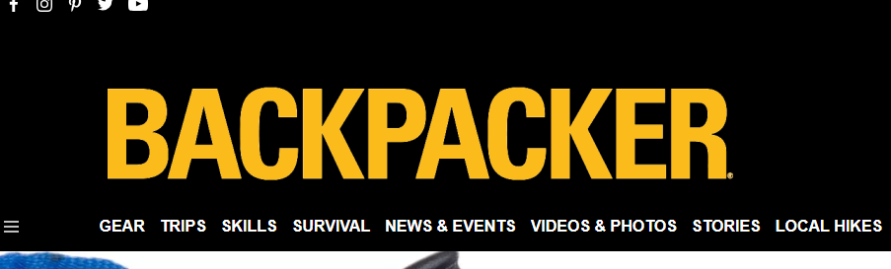
What’s Wrong with Navigation?

Slide 8
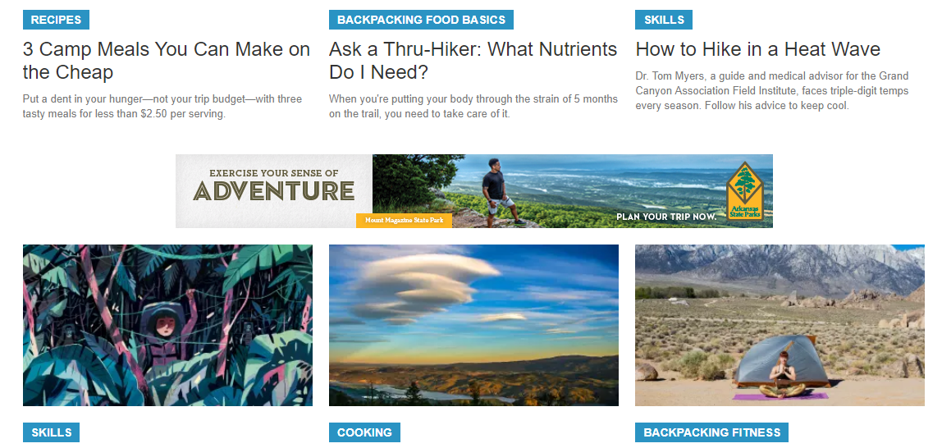
What’s Wrong with the tagging system?

Slide 9
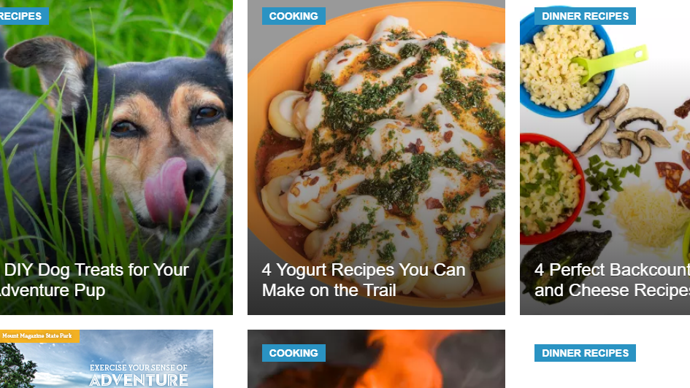

Slide 10
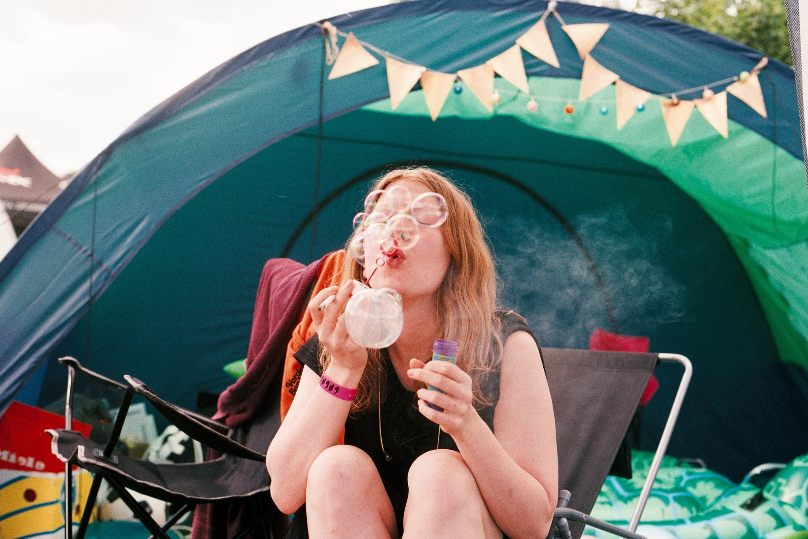
How can we make our site more user friendly?

Slide 11
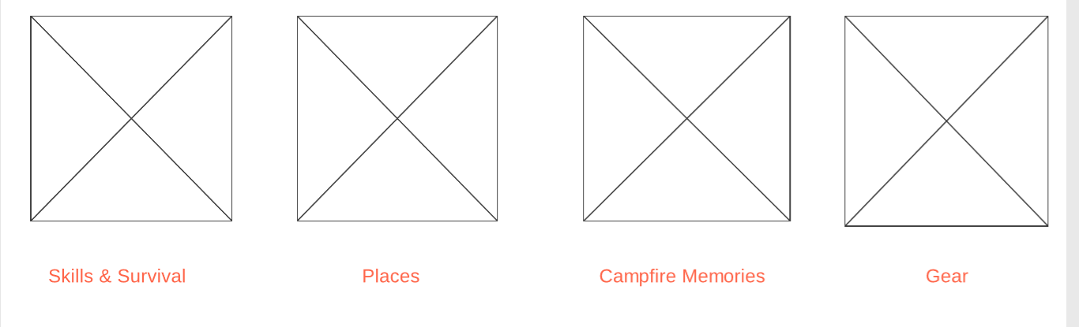
Combine menu topics

Slide 12
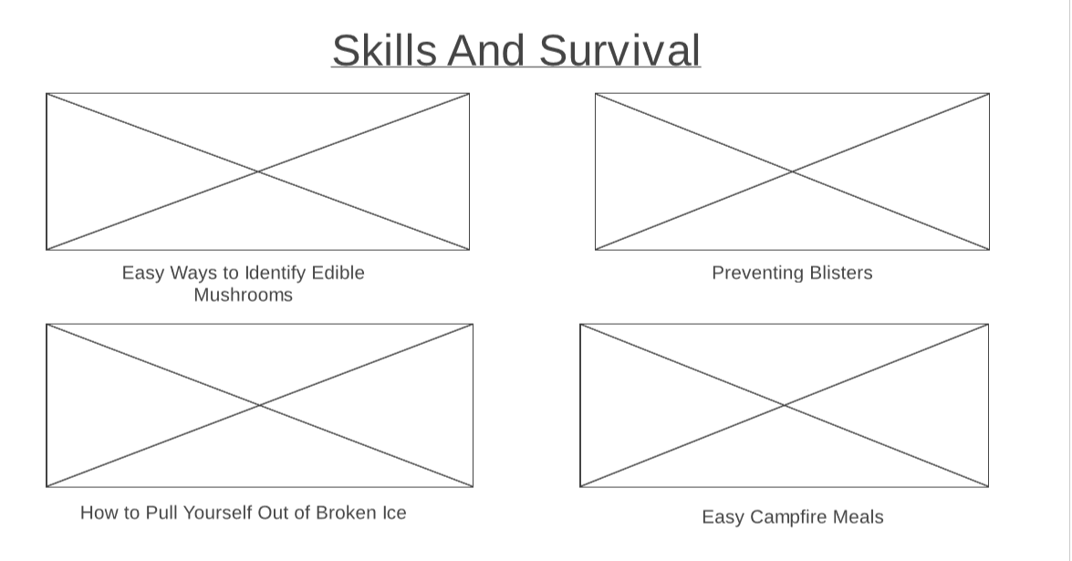

Slide 13
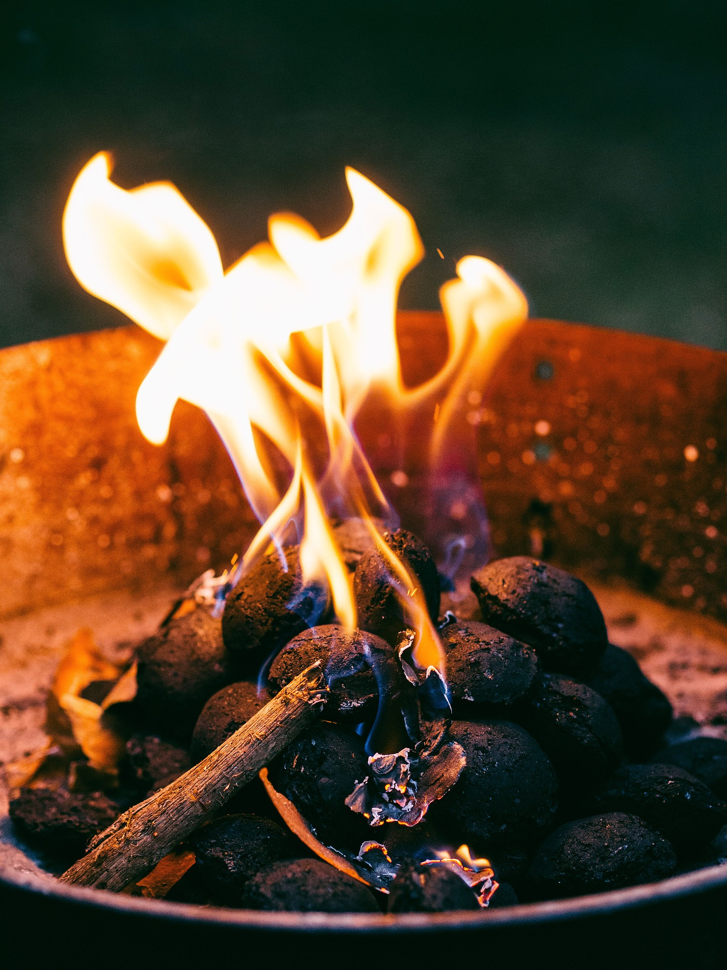
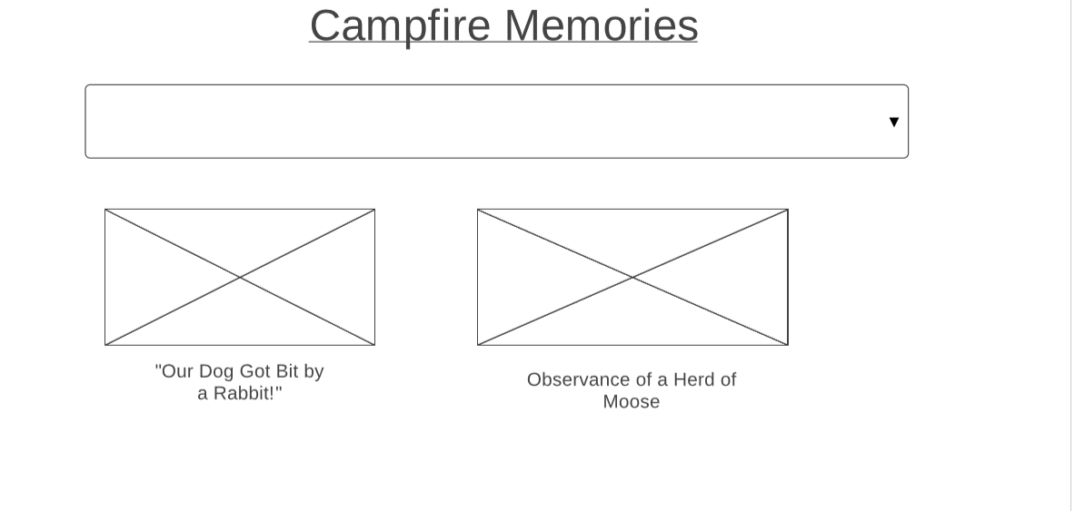

Slide 14
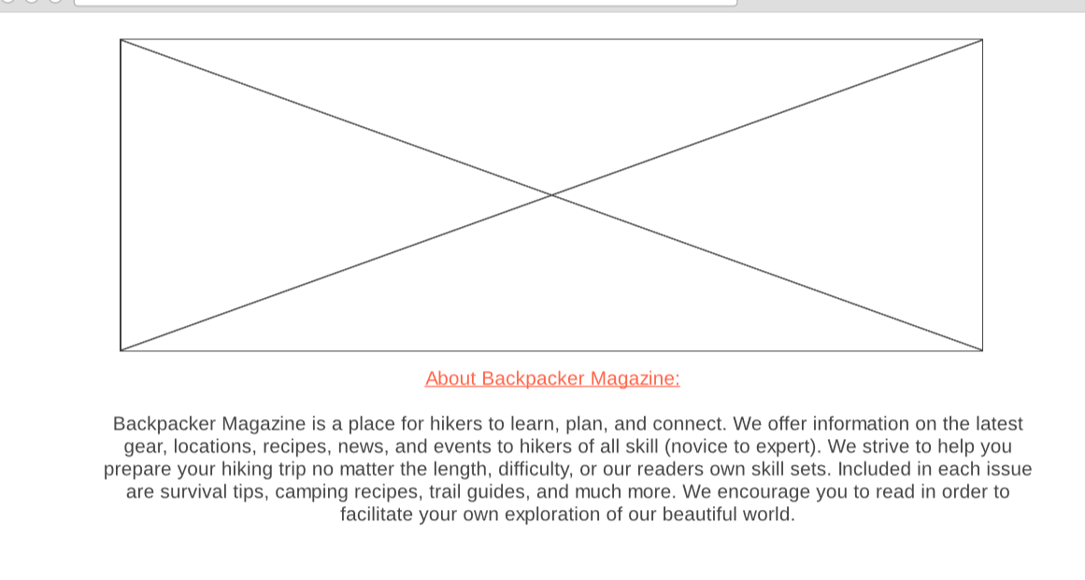

Slide 15
The mighty scroll bar

Slide 16
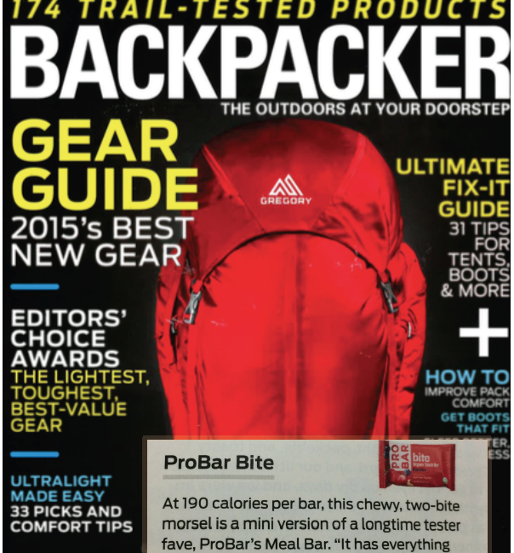
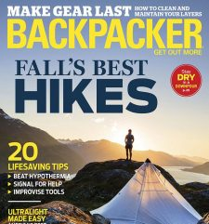
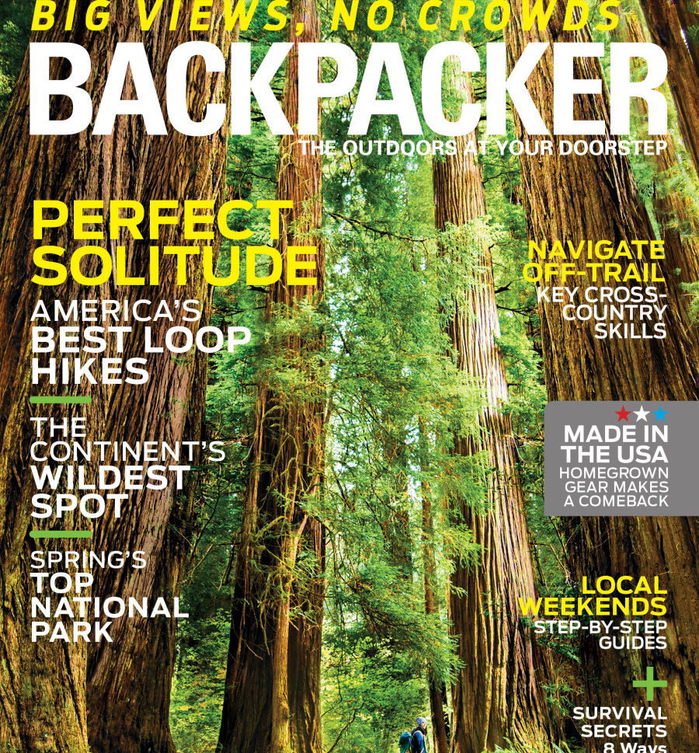
A Better Backpacker

Slide 17

Thank You
Presenter: Erin Sanderson
Email: erinsande15@gmail.com

